Slide 1
Microsoft Teams características y escenarios de migración.
Peter Frank Diaz R
Notes:
This slide is mandatory. Please do not remove.

Slide 2
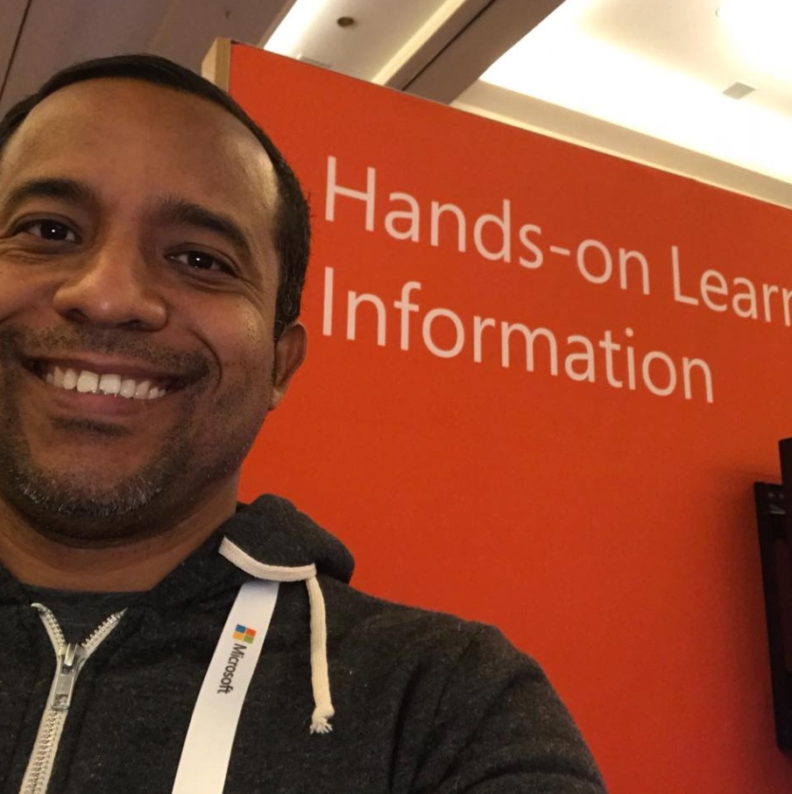
Peter Frank Diaz R
Regional Sales Manager
Swivel Secure
www.ucenespanol.com
@peterdiaz33
Security & UC Senior Consultant

Slide 3
Notes:
This slide is mandatory. Please do not remove and try to use it during Q&A at the end of your session. Thank you!

Slide 4
Microsoft Teams
Características y escenarios de migración

Slide 5
Agenda
Escenarios de migración ONPREM
Escenarios de migración CLOUD
CLOUD ROADMAP
Preguntas y respuestas

Slide 6
Escenarios de migración ONPREM
Office Communications Server 2007 R2 a Skype For Business 2019
OCS 2007 R2, está fuera de soporte
Para migrarlo hay que pasar por Lync 2013 y luego a Skype4B 2019
Skype for Business 2019 tiene dos versiones, Estándar y Enterprise.
Skype for Business 2019 solo soporta SQL Always ON, deja de soportar Clustering y Mirroring.
Windows Server 2016 es soportado para Skype for Business 2019
SQL Server 2017 es soportado para Skype4B 2013 y Skype4B 2019

Slide 7
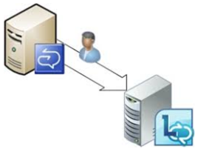

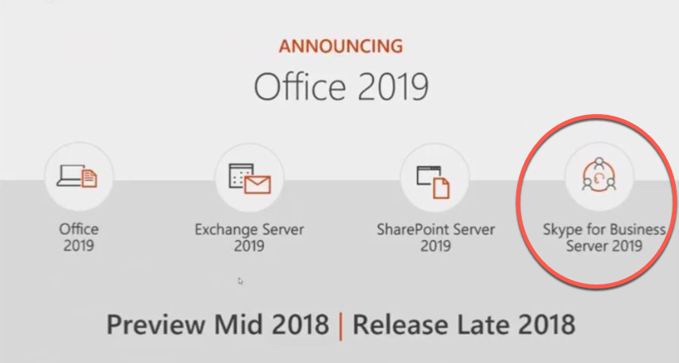
Escenarios de migración ONPREM

Slide 8
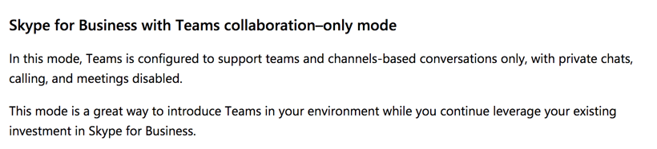

Escenarios de migración CLOUD

Slide 9
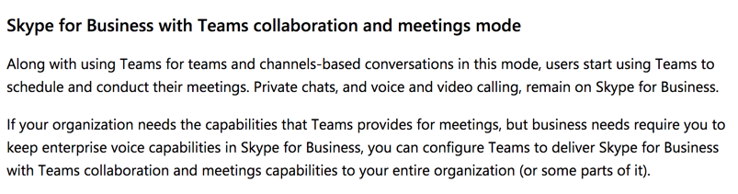
Escenarios de migración CLOUD

Slide 10
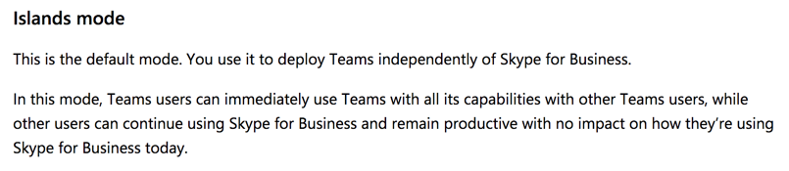
Escenarios de migración CLOUD

Slide 11
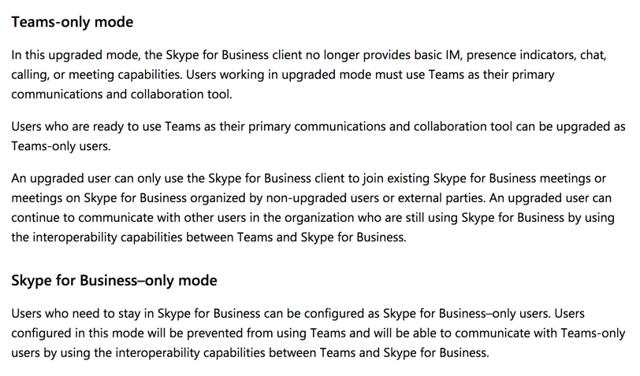
Escenarios de migración CLOUD

Slide 12
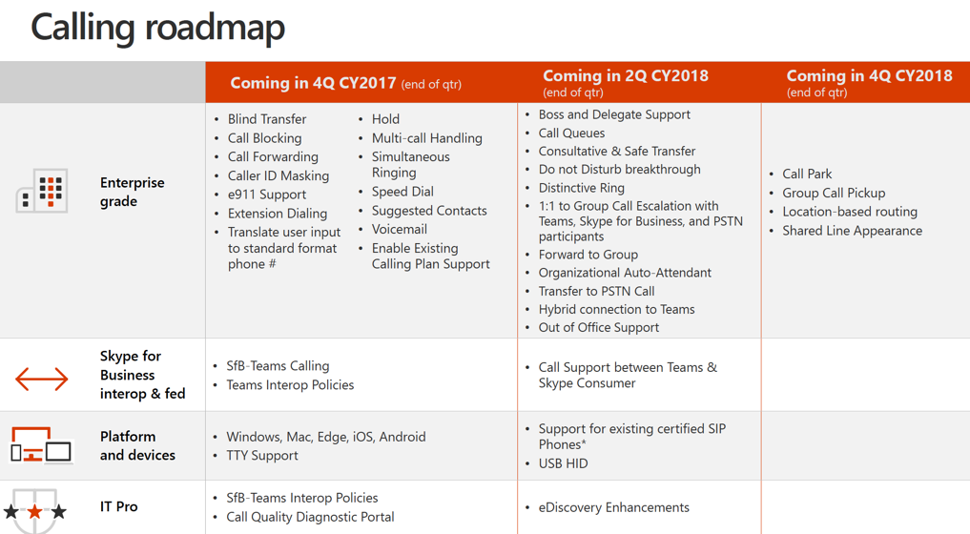
CLOUD ROADMAP

Slide 14
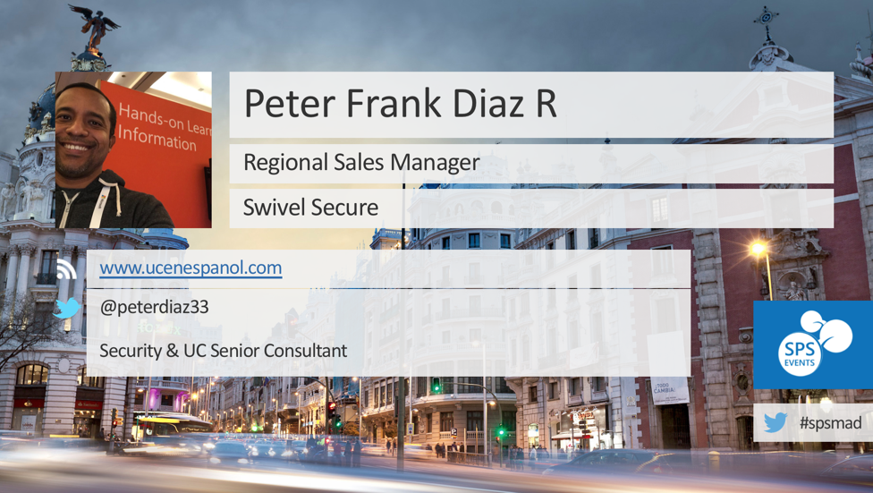
THANKS

Slide 15
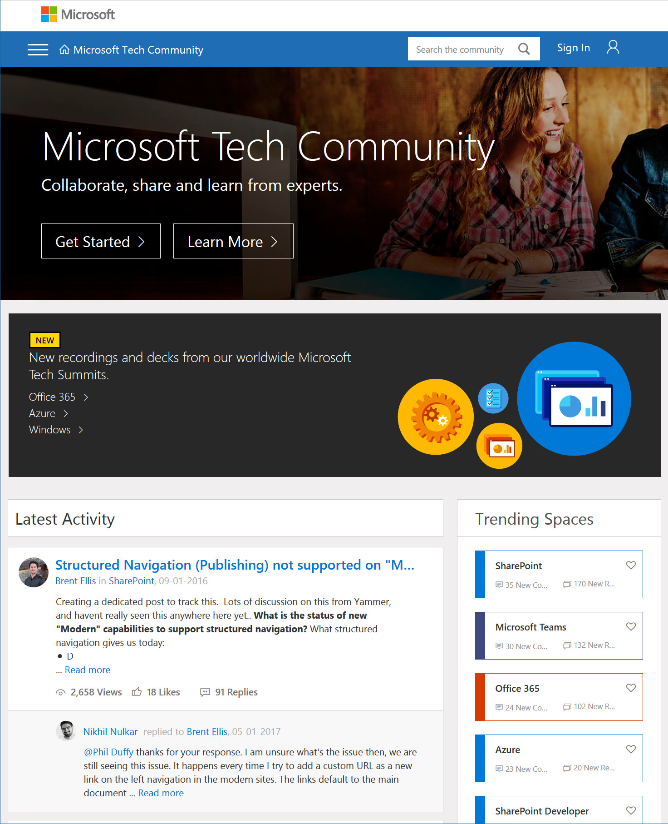
Microsoft Tech Community
techcommunity.microsoft.com
One Microsoft community for IT Pros and tech enthusiasts to learn from experts on Microsoft products
Trusted resource for news, best practices and answers from Microsoft product teams and MVPs
Join today! It’s free – sign in with your Microsoft Account.

Slide 16
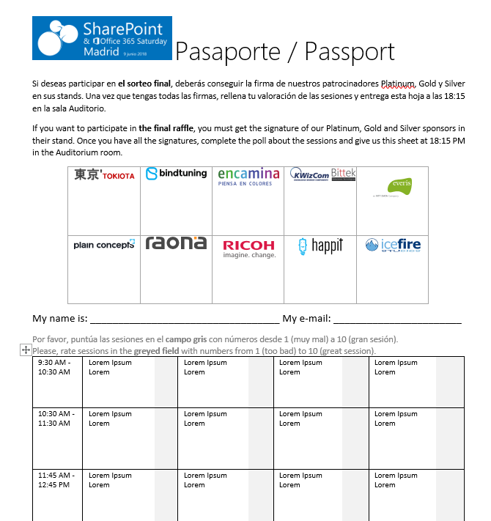




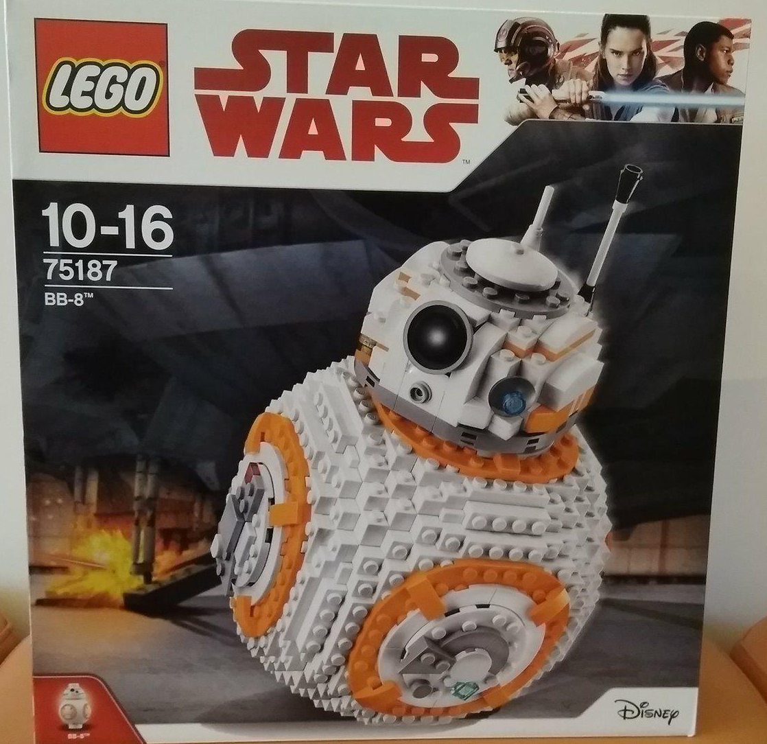


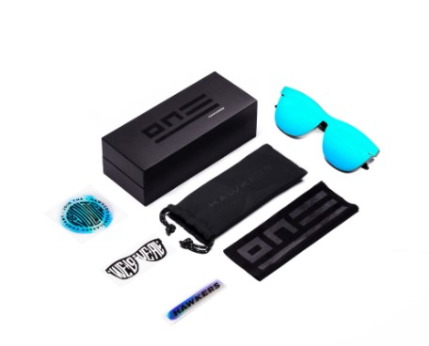








Raffle
Please, fill your SP & Office 365 Saturday Madrid passport if you want to participate.
You can win one of these gifts:
Please, fill your SP & Office 365 Saturday Madrid passport if you want to participate.
You can win one of these gifts:
Odor
Odor@winterfell.com
10
9
2x
2x
8

Slide 17
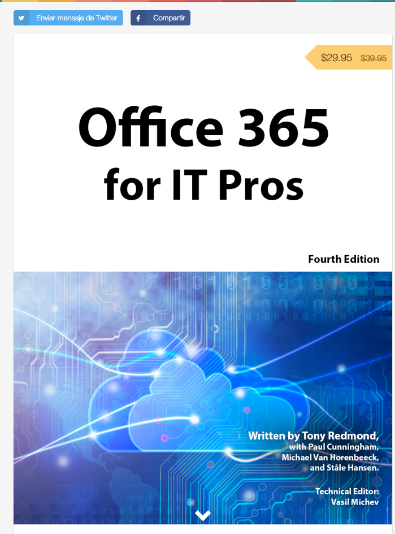
Office 365 for IT Pros
Get a discount of $10 buying the book here: https://gumroad.com/l/O365IT/spsspain

Slide 18
Notes:
This slide is mandatory. Please do not remove and try to use it during Q&A at the end of your session. Thank you!

Slide 19
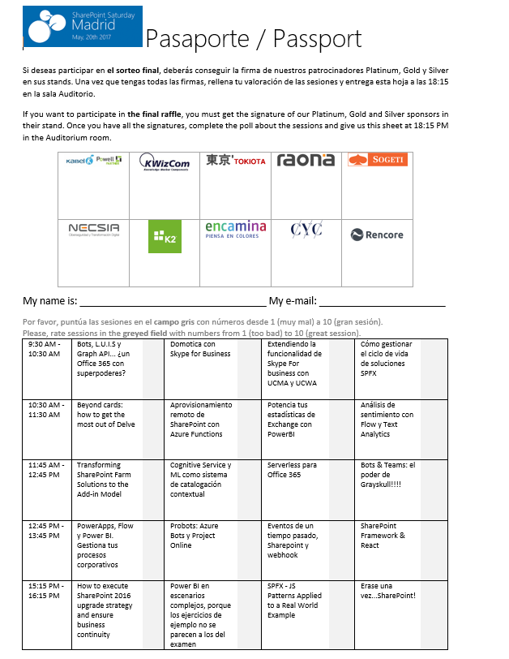
Raffle
Please, fill your SP & Office 365 Saturday Madrid passport if you want to participate.
You can win one of these gifts:
Odor
Odor@winterfell.com
10
9
8

